Slide 1
MERCER COUNTY AMATEUR RADIO CLUB
Milestone
Events
Announcement
April 26, 2016

Slide 2
MERCER COUNTY AMATEUR RADIO CLUB
Atlantic Tower Co. (ATC) acquires AT&T Keel Ridge tower site
K3AWS’s D-STAR rptr moves to Keel Ridge from Atlantic, PA
Milestone
Events
Announcement
April 26, 2016
Cory Gibson & Mike Mowery join W3LIF repeater committee
ATC offers MCARC use of facilities at Keel Ridge tower site

Slide 3
MERCER COUNTY AMATEUR RADIO CLUB
Atlantic Tower Co. (ATC) acquires AT&T Keel Ridge tower site
Event
#1
April 26, 2016

Slide 4
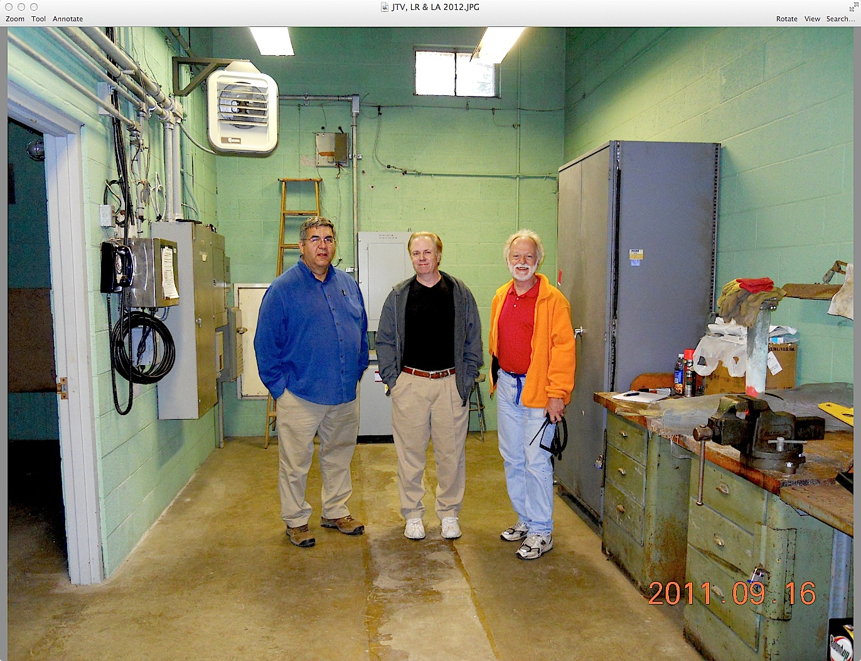
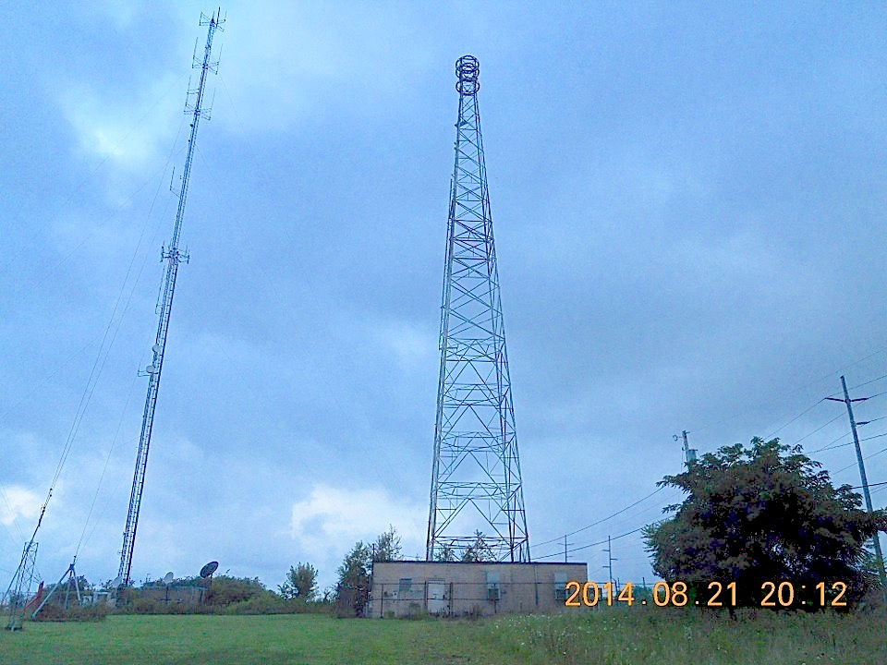
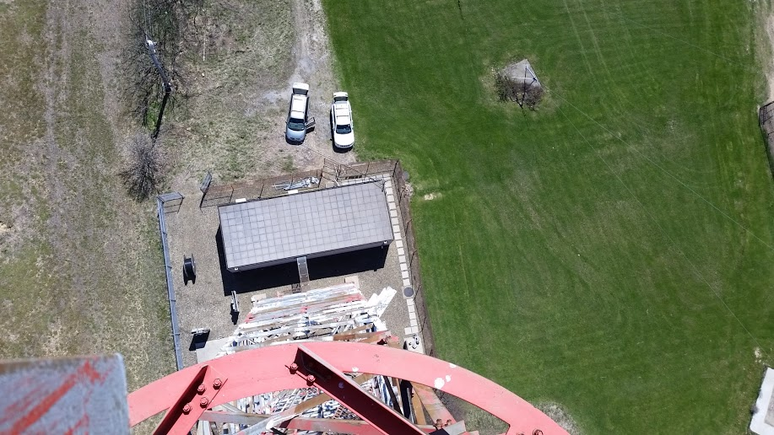
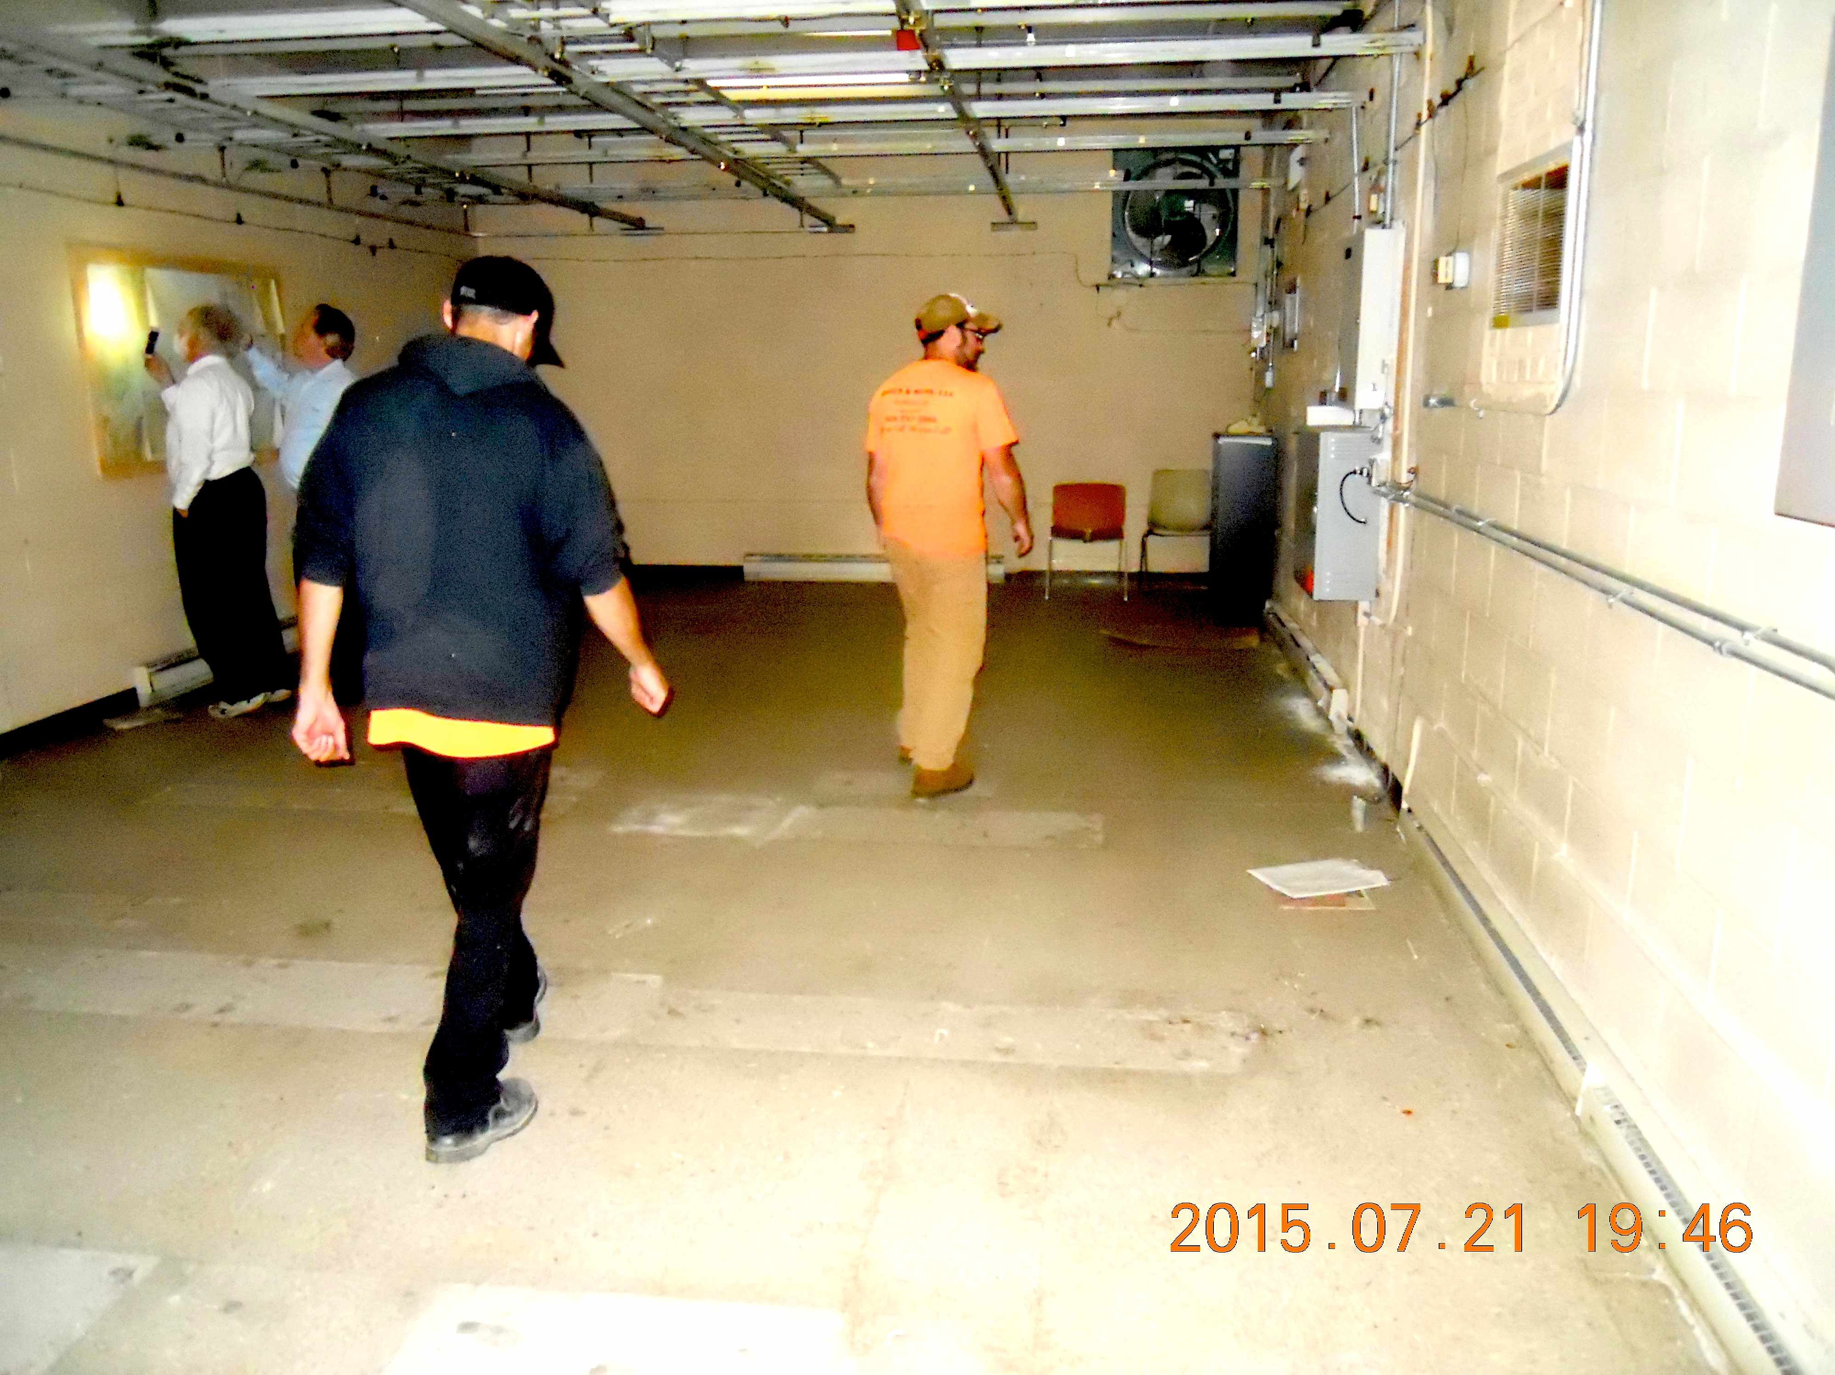
MERCER COUNTY AMATEUR RADIO CLUB
Atlantic Tower Company (ATC) acquires AT&T Keel Ridge tower site

Slide 5
Atlantic Tower Company
Partners

Slide 6
Atlantic Tower Company
ATC acquisition of Keel Ridge AT&T Tower in Uptown Hermitage includes: 0.6 acre property, with a 199’ self-supporting tower and masonry equipment building with single phase electricity.

Slide 7
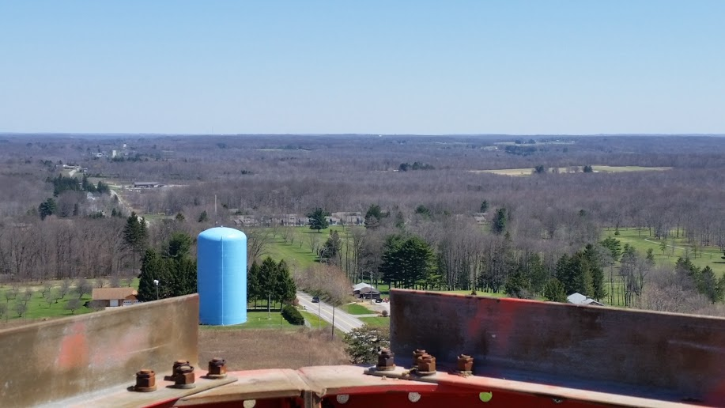
Atlantic Tower Company
From the top of the Keel Ridge ATC Tower, the existing W3LIF antenna can be seen approximately 100’ below.

Slide 8
Atlantic Tower Company
After minor refurbishing and cleanup, the Keel Ridge ATC Tower’s 35 yo equipment building will be ready to house amateur radio rigs and activities.

Slide 9
Atlantic Tower Company
Interior of the 20’ x 40’ building is empty of its former AT&T microwave equipment but capable of housing much amateur or public service resources.

Slide 10
MERCER COUNTY AMATEUR RADIO CLUB
K3AWS’s D-STAR rptr moves to Keel Ridge from Atlantic, PA
Event
#2
April 26, 2016

Slide 11
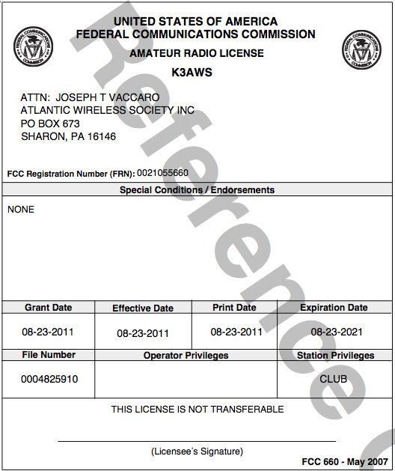
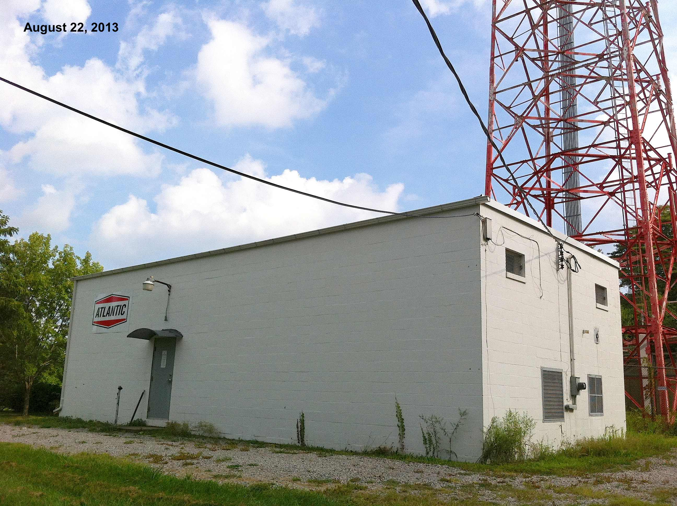
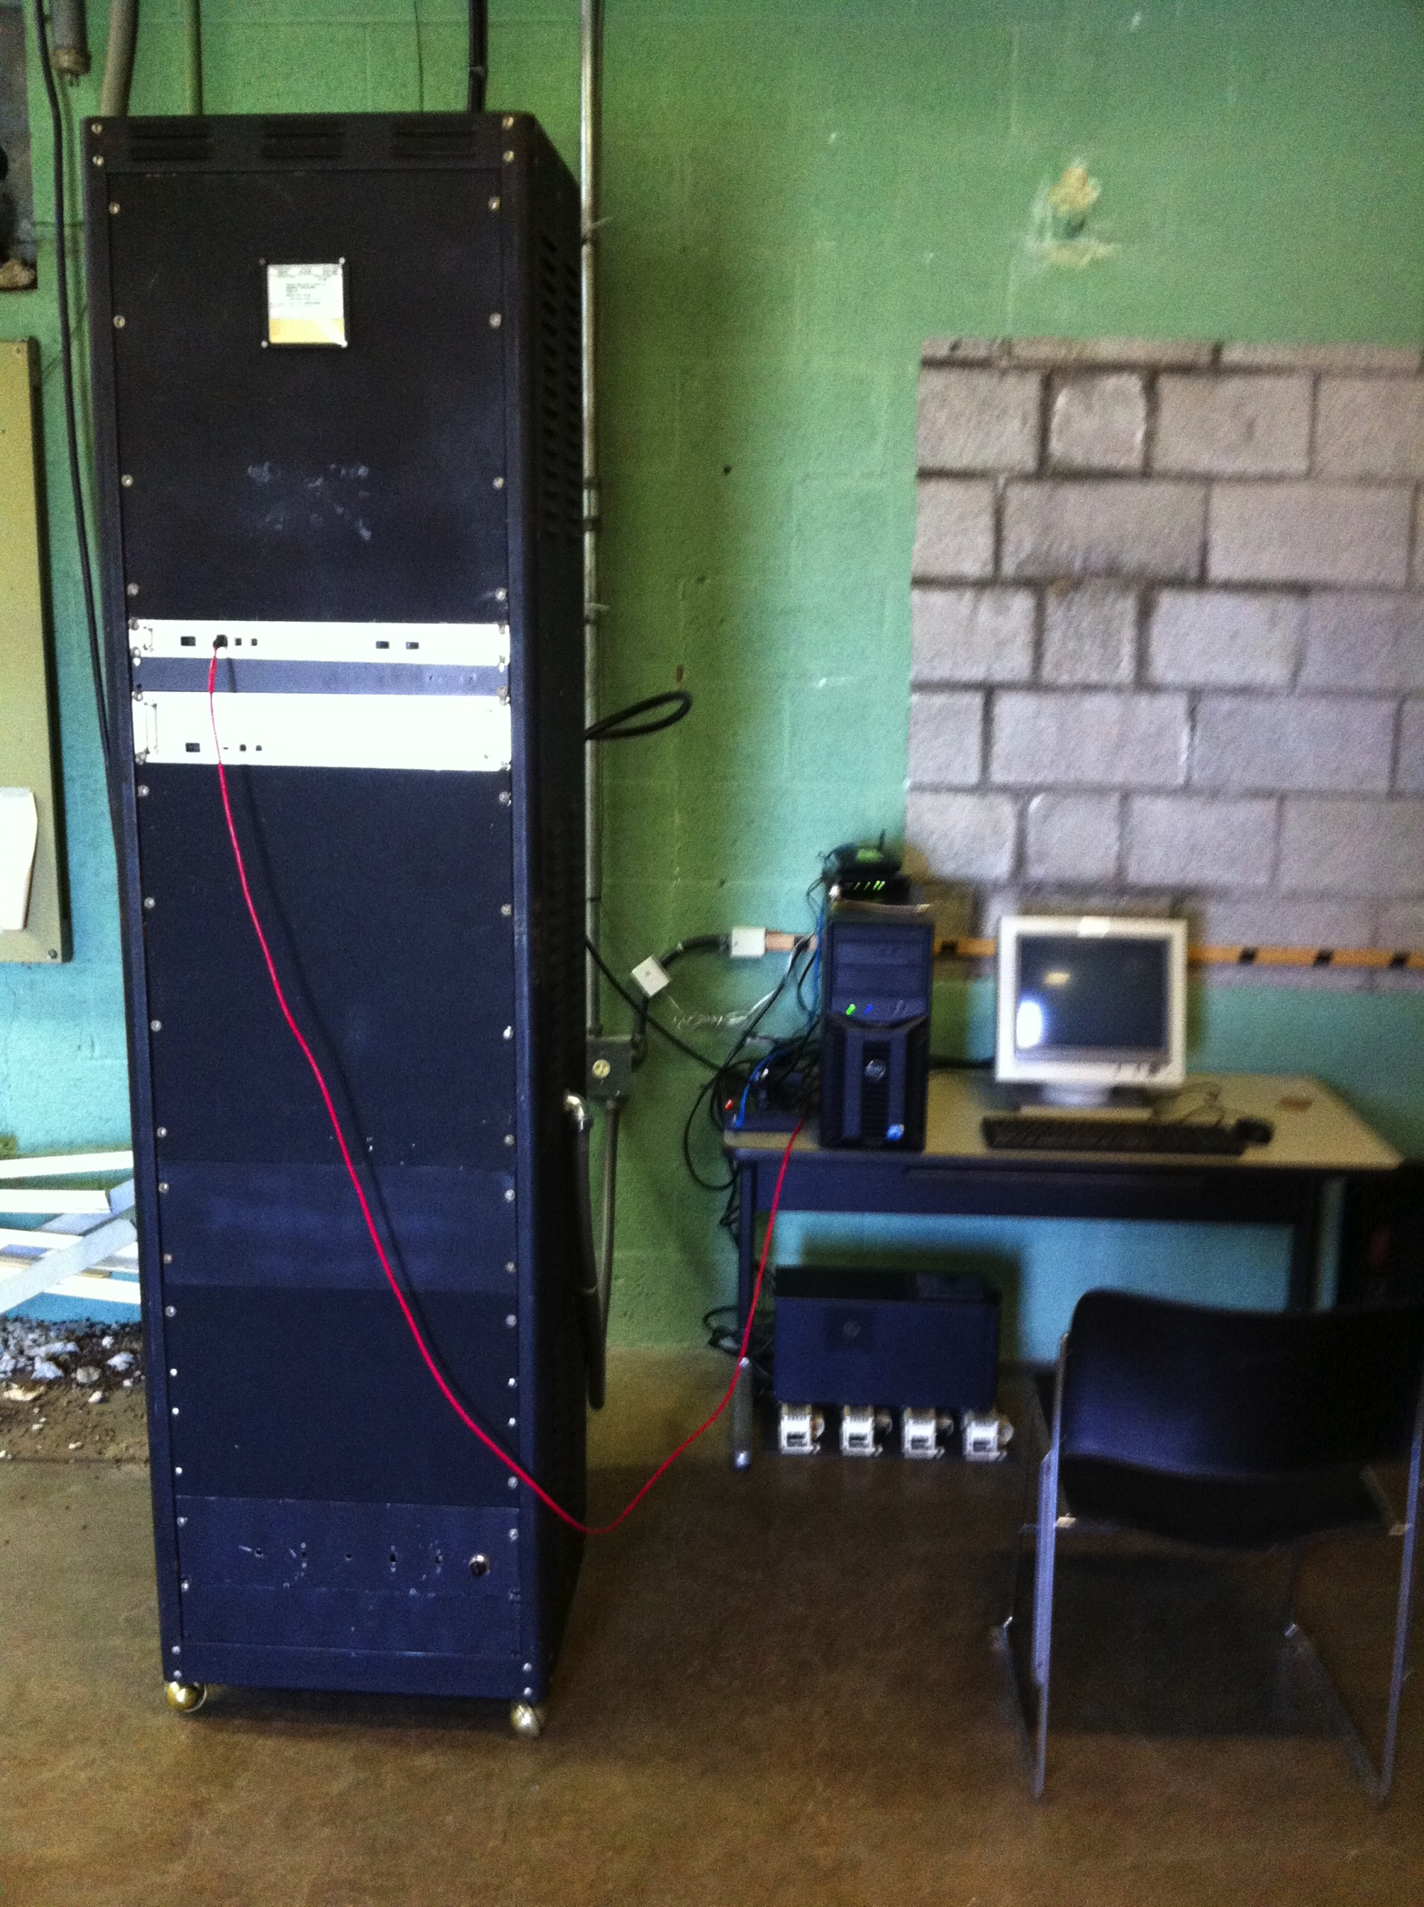
MERCER COUNTY AMATEUR RADIO CLUB
K3AWS’s D-STAR repeater moves to Keel Ridge from Atlantic, PA

Slide 12
K3AWS – Atlantic Wireless Society
Original home of K3AWS and its D-STAR repeater in Atlantic, Pennsylvania

Slide 13
K3AWS – Atlantic Wireless Society
Amateur Radio License for the D-STAR repeater

Slide 14
K3AWS – Atlantic Wireless Society
Amateur Radio D-STAR repeater to be moved from Atlantic to Keel Ridge in Hermitage, PA

Slide 15
K3AWS – Atlantic Wireless Society
Current condition of interior at Keel Ridge, Hermitage being offered to house W3LIF 2-meter repeater with the Society’s K3AWS D-STAR equipment.

Slide 16
MERCER COUNTY AMATEUR RADIO CLUB
Event
#3
April 26, 2016
Cory Gibson & Mike Mowery join W3LIF repeater committee

Slide 17
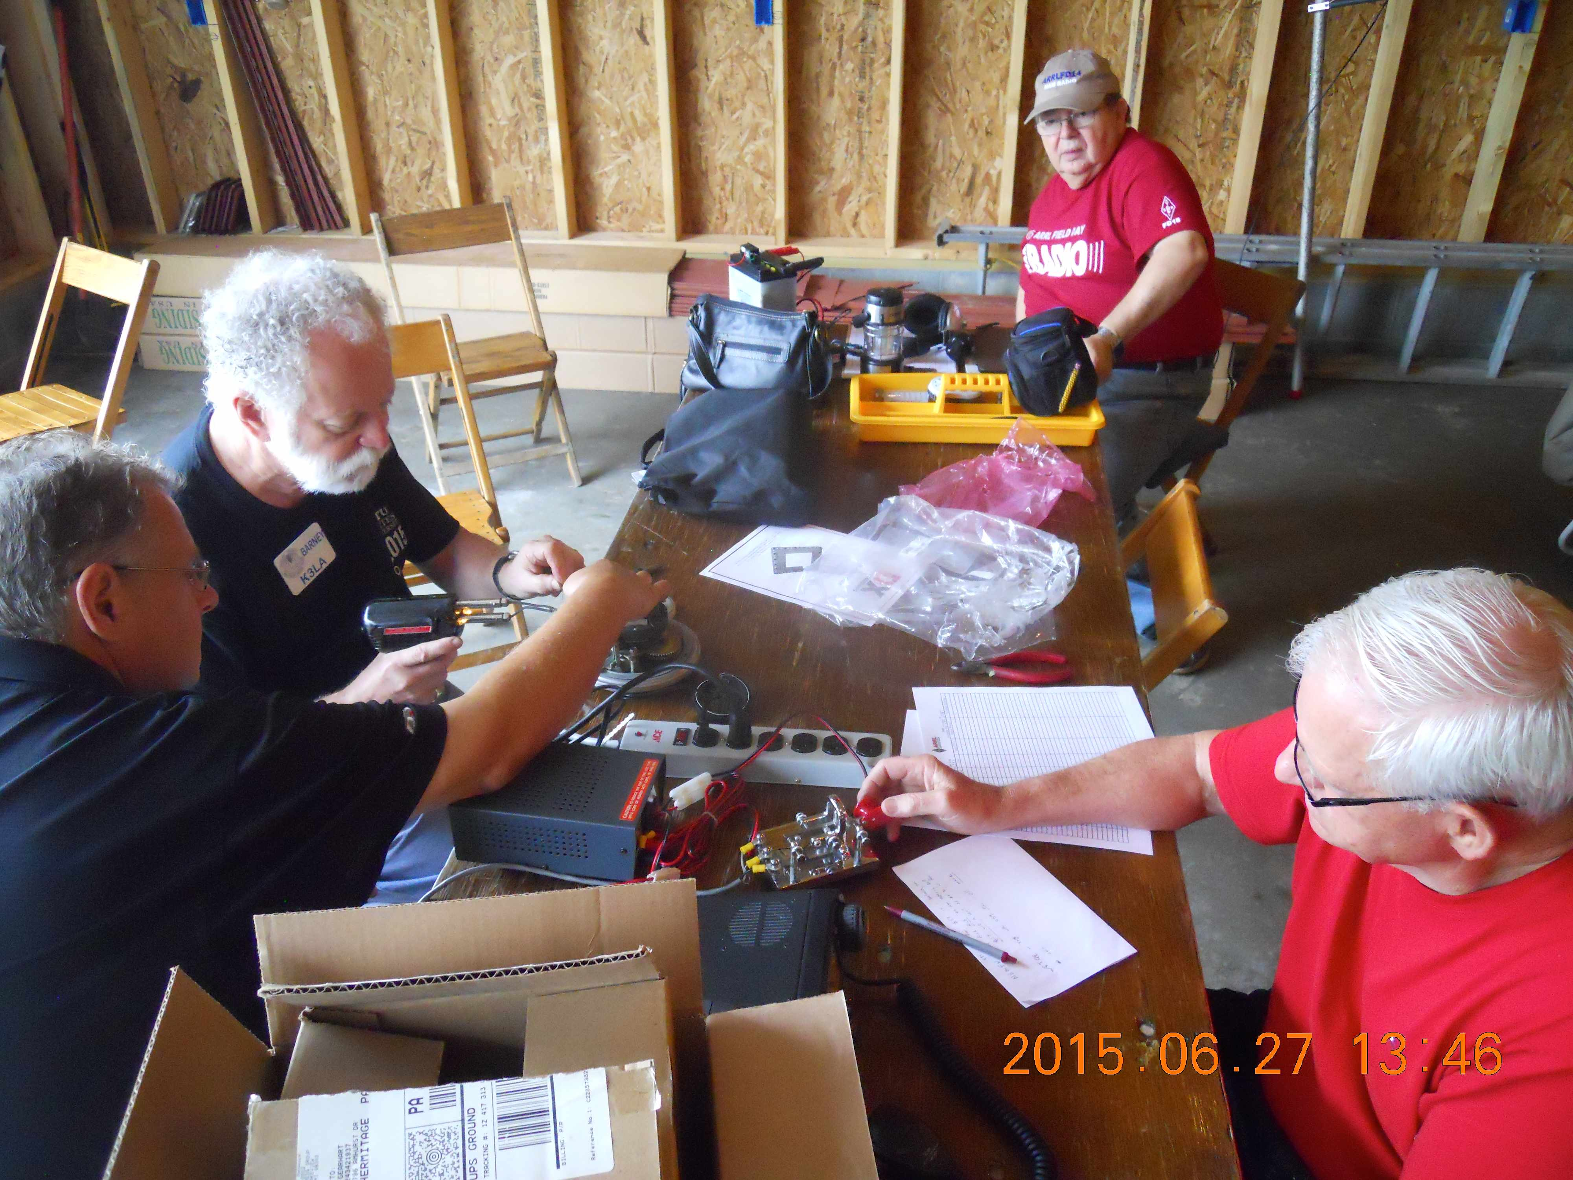
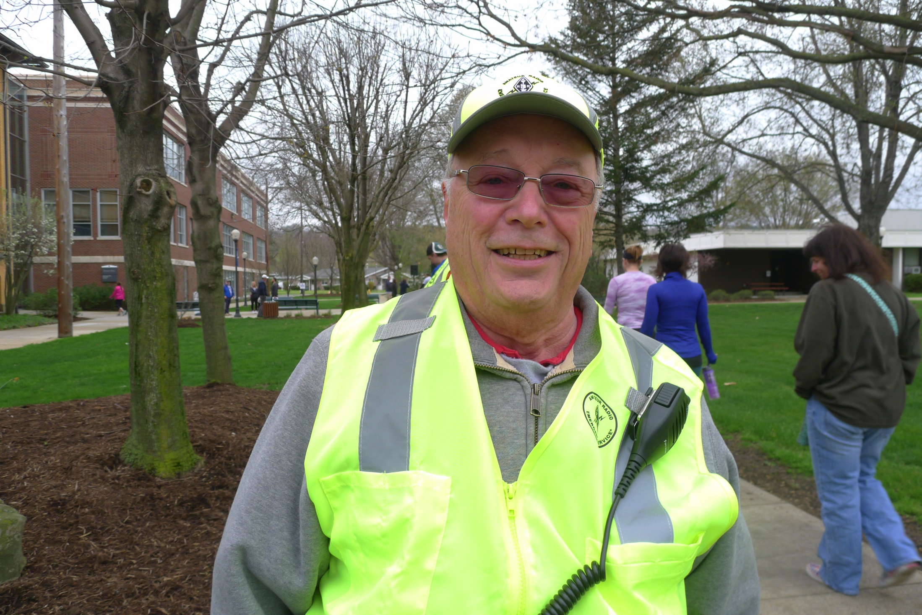
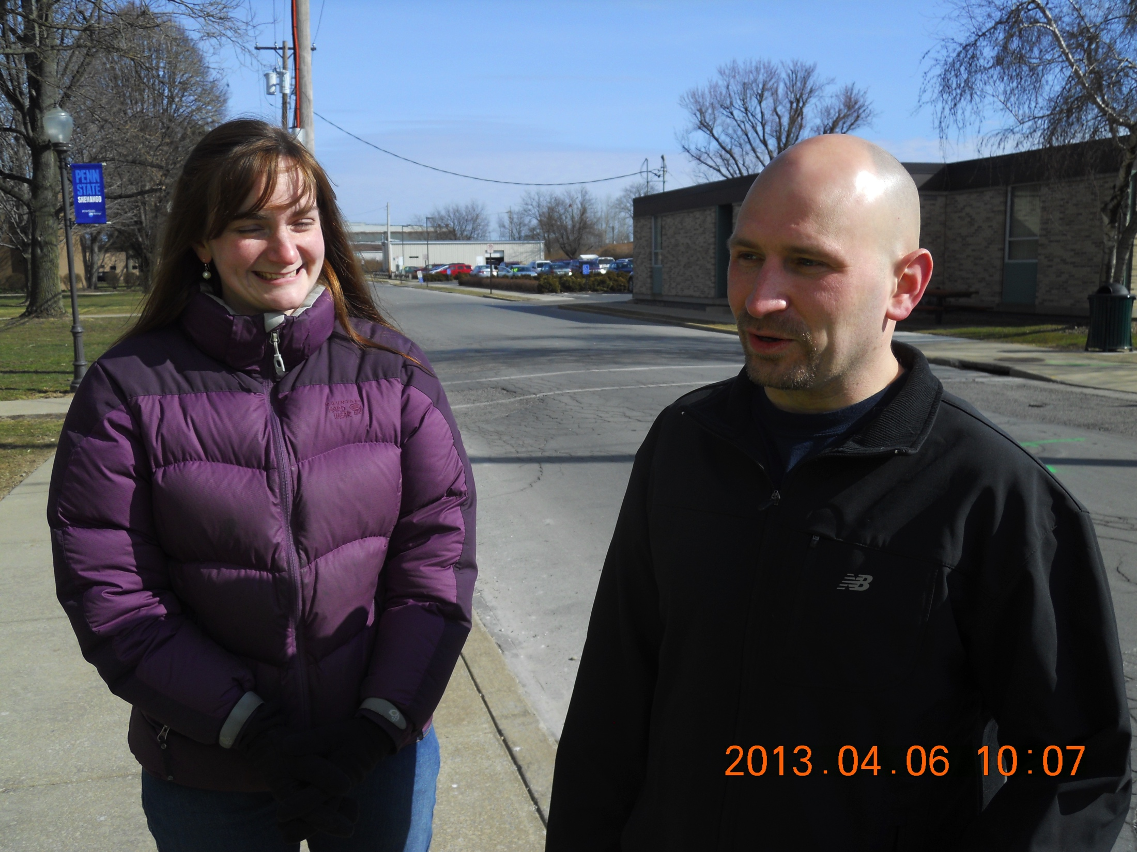
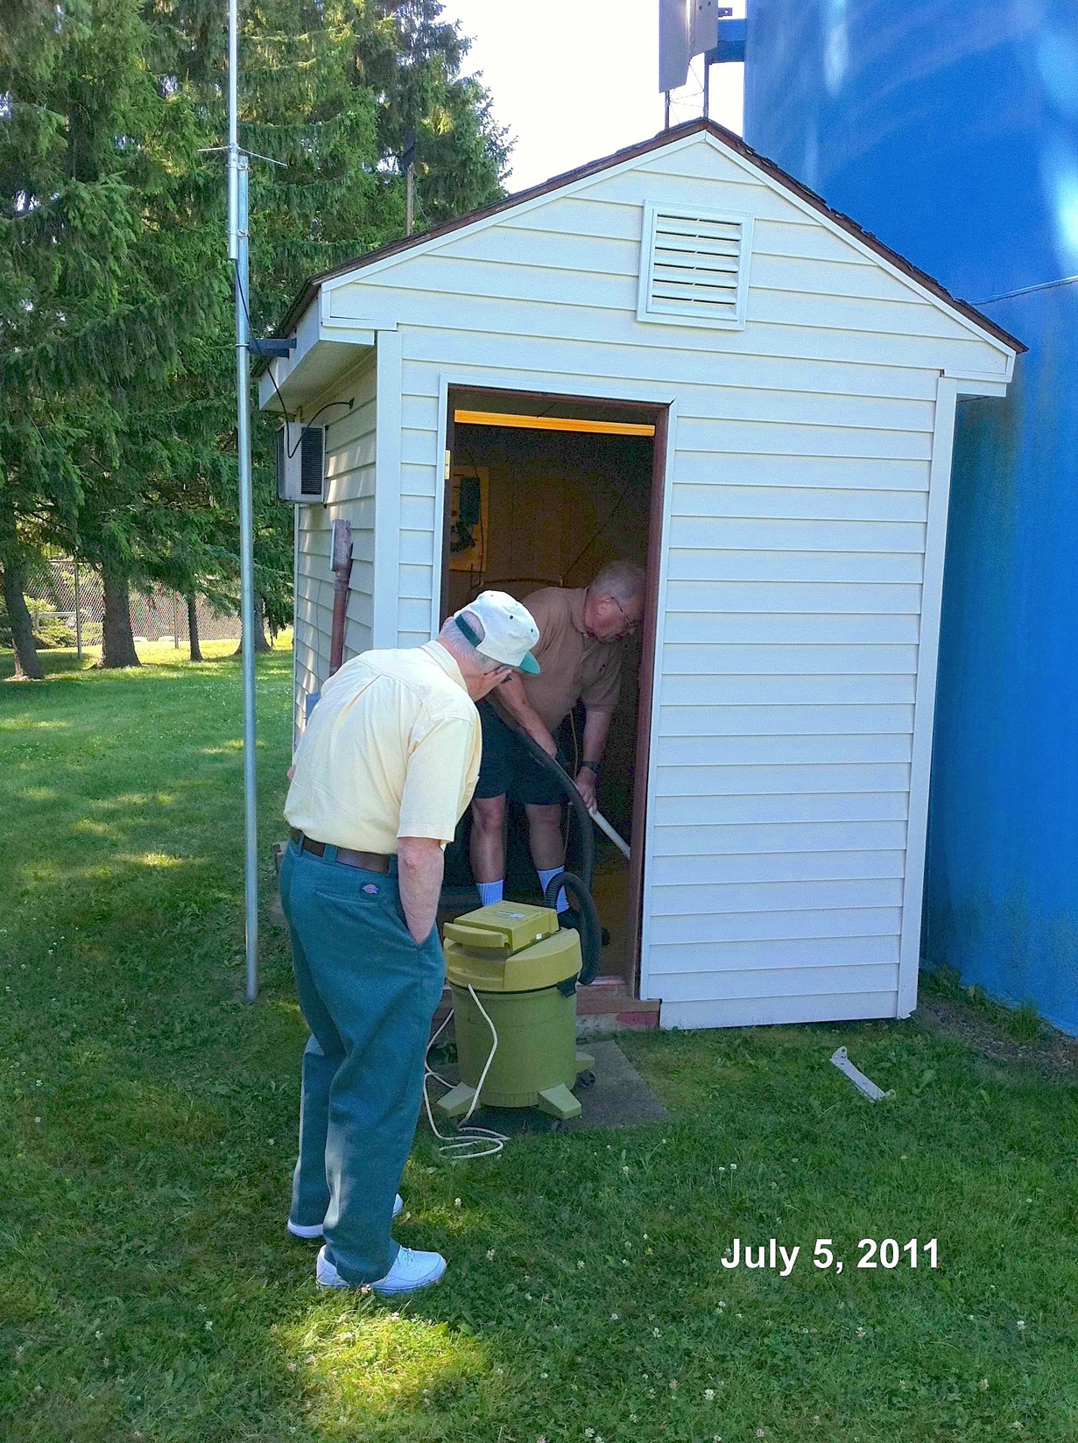
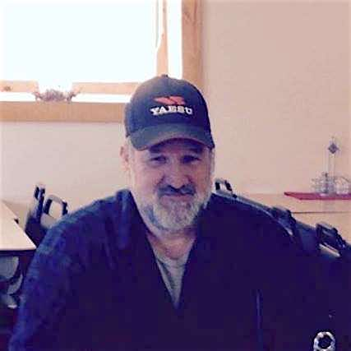
MERCER COUNTY AMATEUR RADIO CLUB
Cory Gibson & Mike Mowery join W3LIF repeater committee
April 26, 2016
Barney Scholl, K3LA
Doug Noderer, W3FYV
Club License Trustee
W3FYV
AA3EW, SK

Slide 18
W3LIF Repeater Committee
Barney Scholl, K3LA, trustee of club license, W3LIF.

Slide 19
W3LIF Repeater Committee
Doug Noderer, W3FYV, committee member and HEARS chairman.

Slide 20
W3LIF Repeater Committee
Doug Noderer, W3FYV, with committeeman / past HEARS chairman Steve Shemancik, AA3EW, SK.

Slide 21
W3LIF Repeater Committee New committee members
Cory Gibson, W3CDG
Mike Mowery, KE3JP

Slide 22
MERCER COUNTY AMATEUR RADIO CLUB
Event
#4
April 26, 2016
ATC offers MCARC use of facilities at Keel Ridge tower site

Slide 23
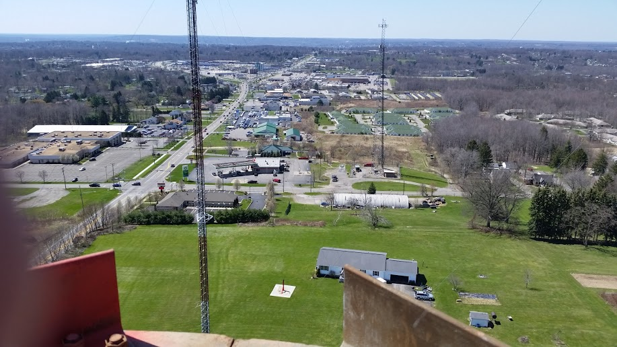
Downtown Hermitage AMATEUR RADIO CLUB
ATC plans for its Hermitage site to be use by MCARC. Details are incomplete...

Slide 24
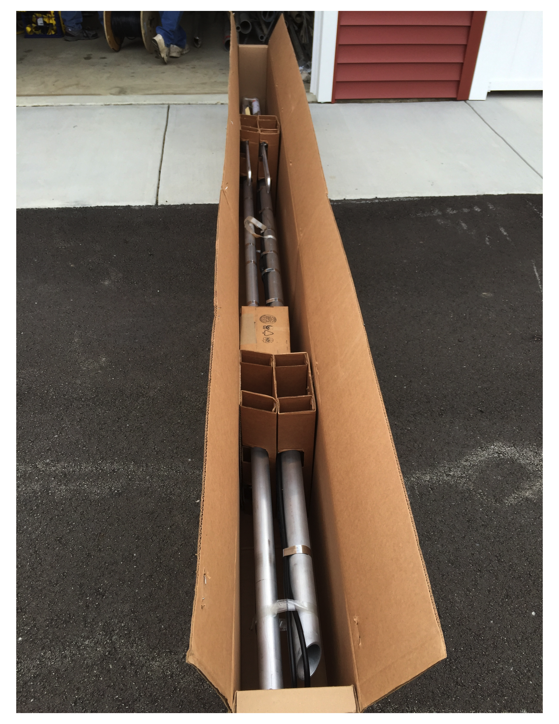
A new Andrew 4-pole 2M antenna will be installed atop the ATC tower. The existing 2M antenna on the current water tank tower will remain until the tank is removed by Aqua PA.

Slide 25
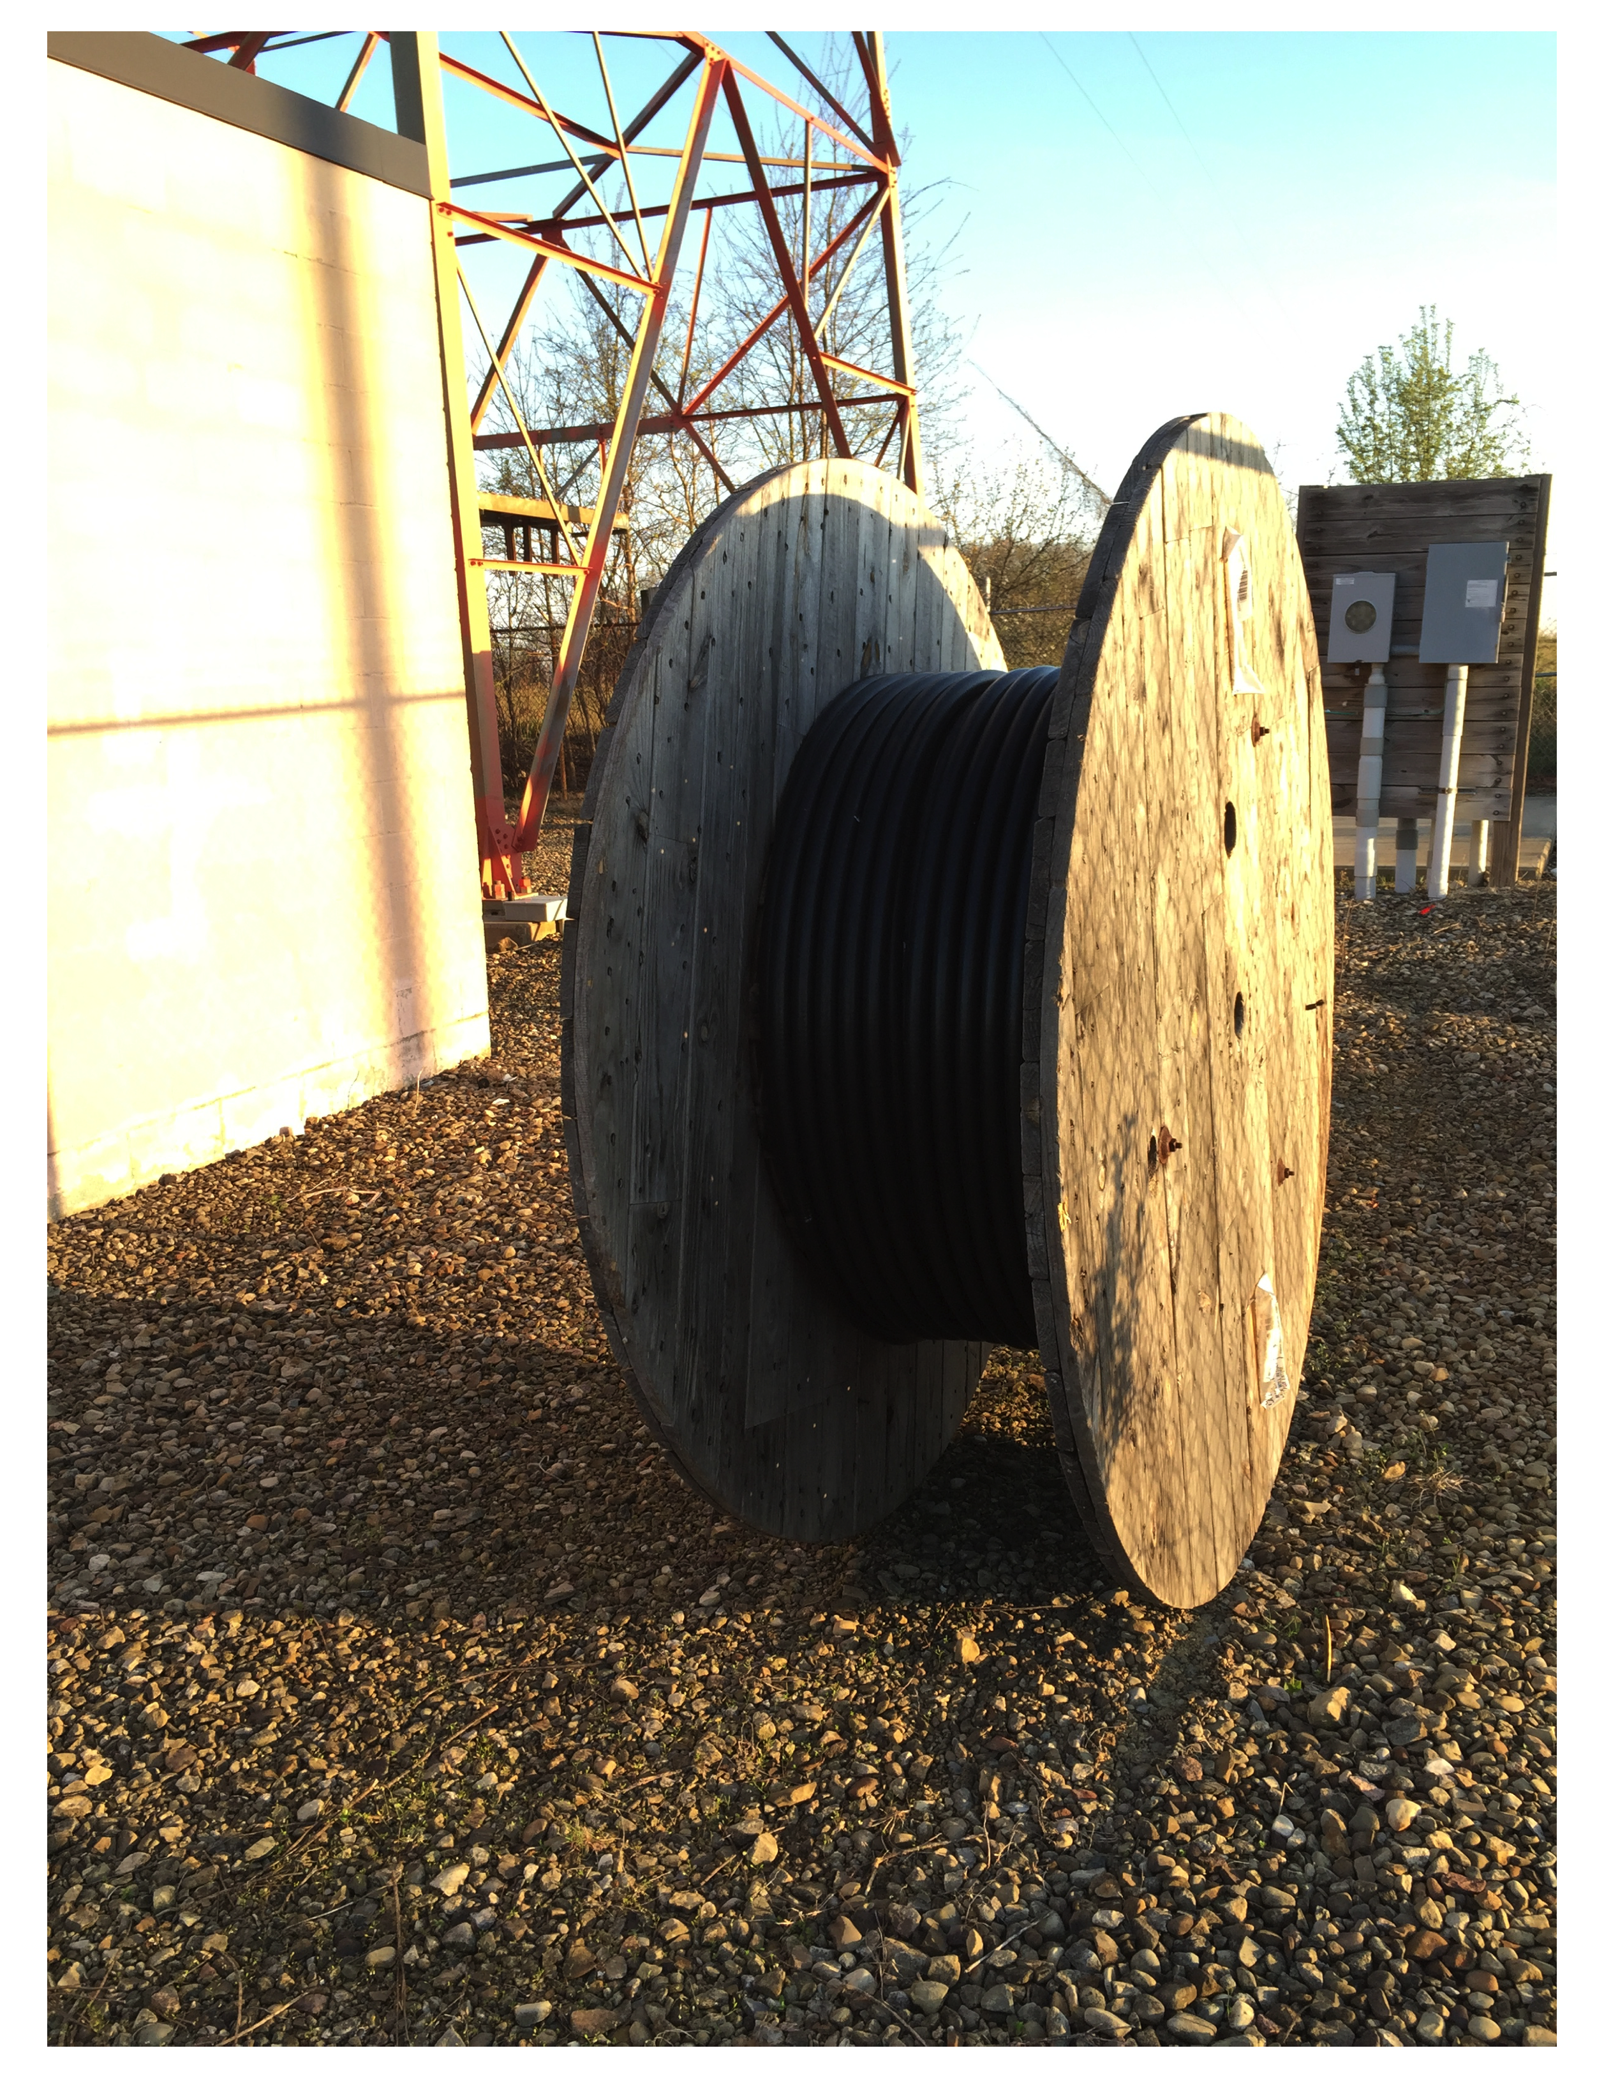
1-1/4” Andrew feed line will hopefully also help to give the repeater better performance and less noise.

Slide 26
MERCER COUNTY AMATEUR RADIO CLUB
… but, its hoped the club can call these accommodations ‘home’.

Slide 27
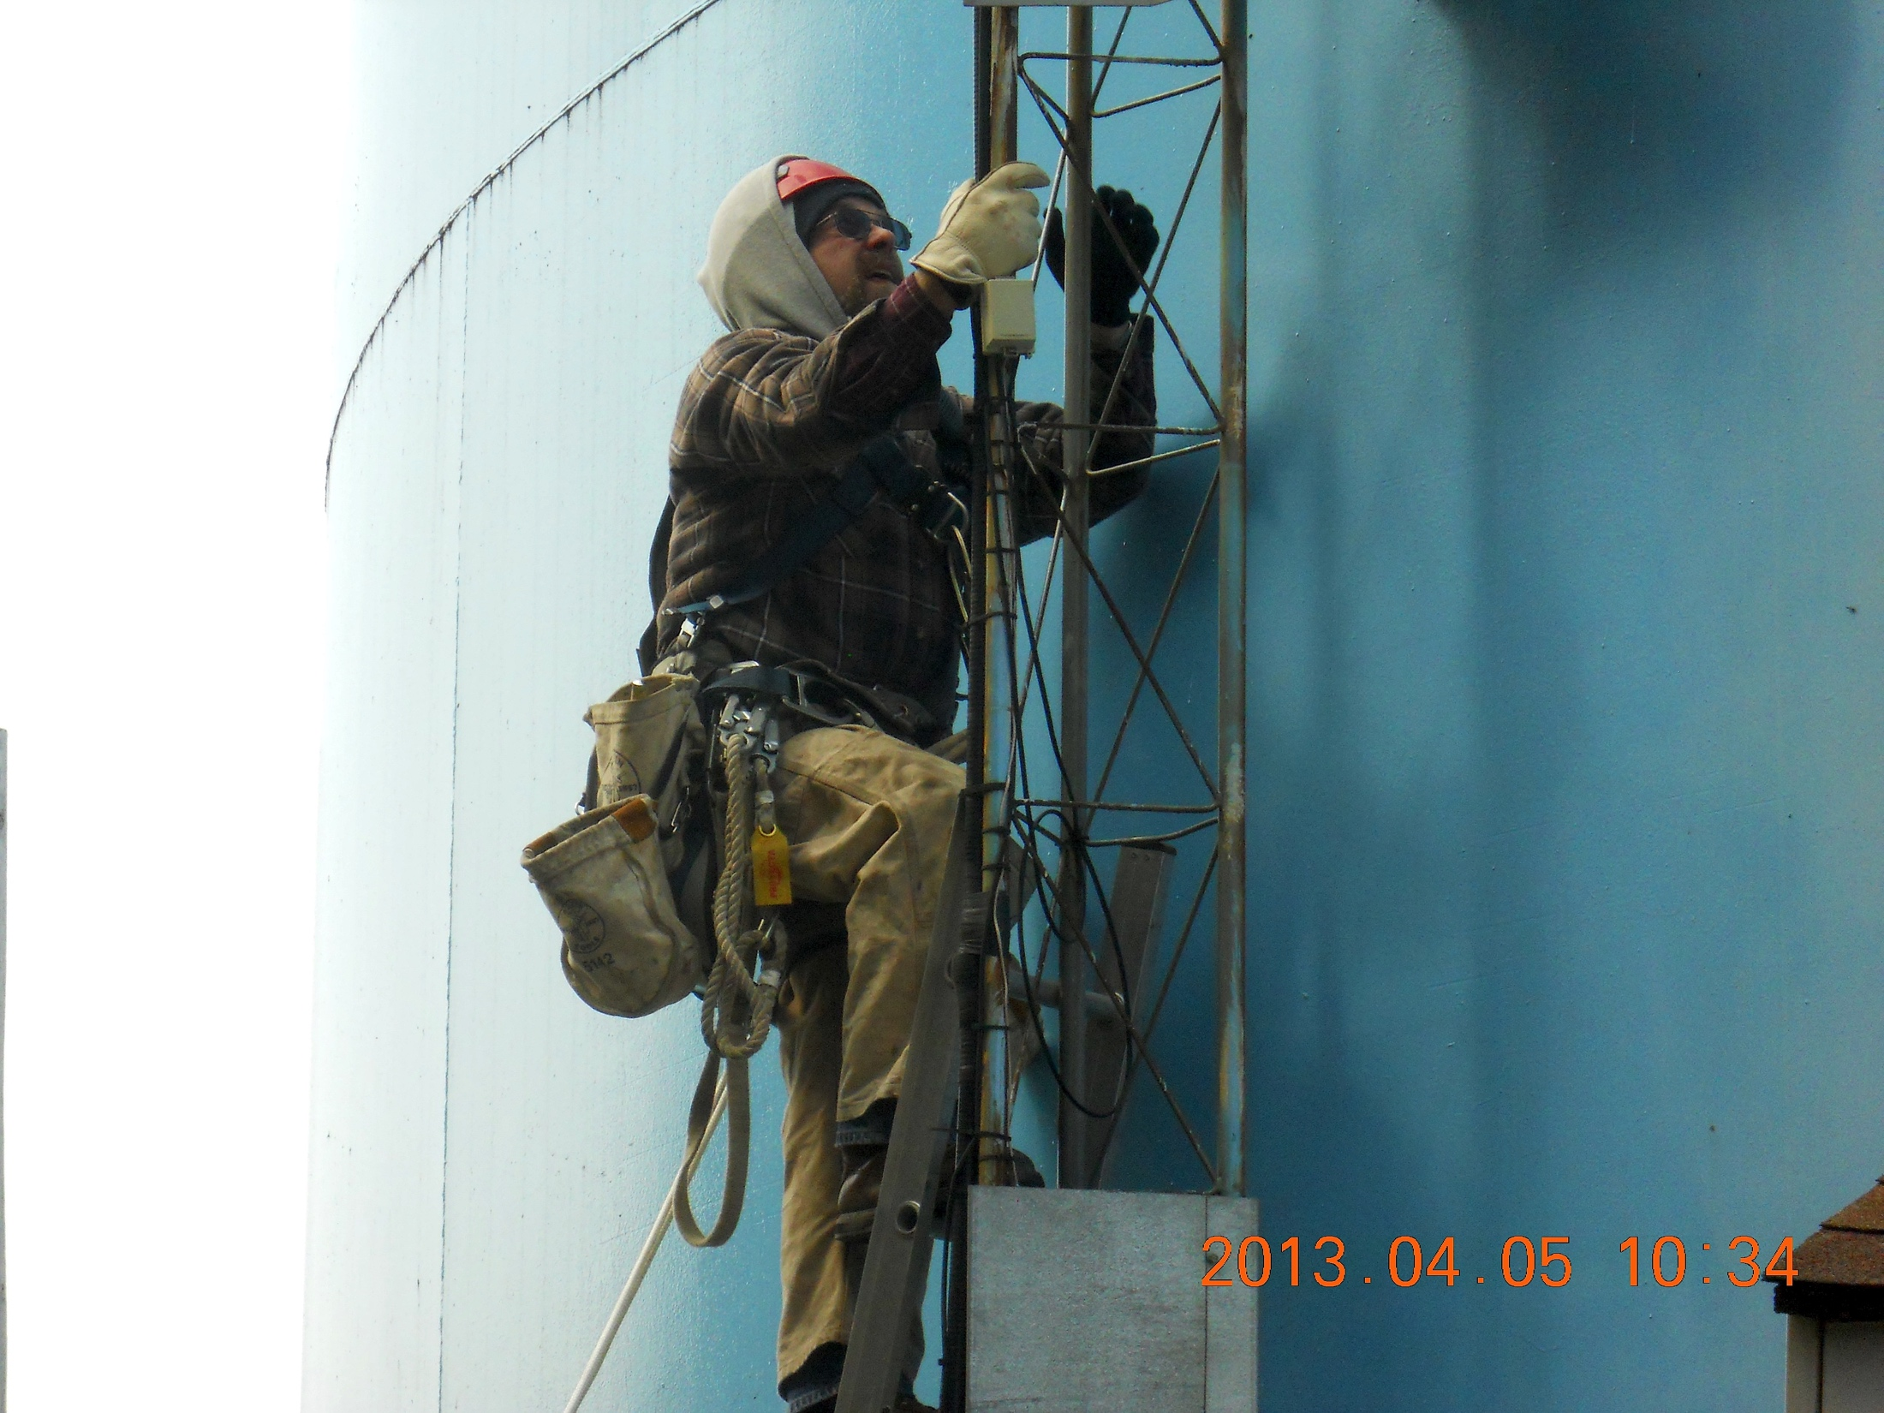
Written and directed by Joe Vaccaro, W3JTV. Projected by Tom Pryts, N3NTF and Josh Bradac, N3FNG. Music: Etude #3 in E, Op. 10/3 by Frédéric Chopin. © 2016
Tower maintenance, antenna installation and aerial photos by Tim Jellison, W3YQ.

